Slide 1
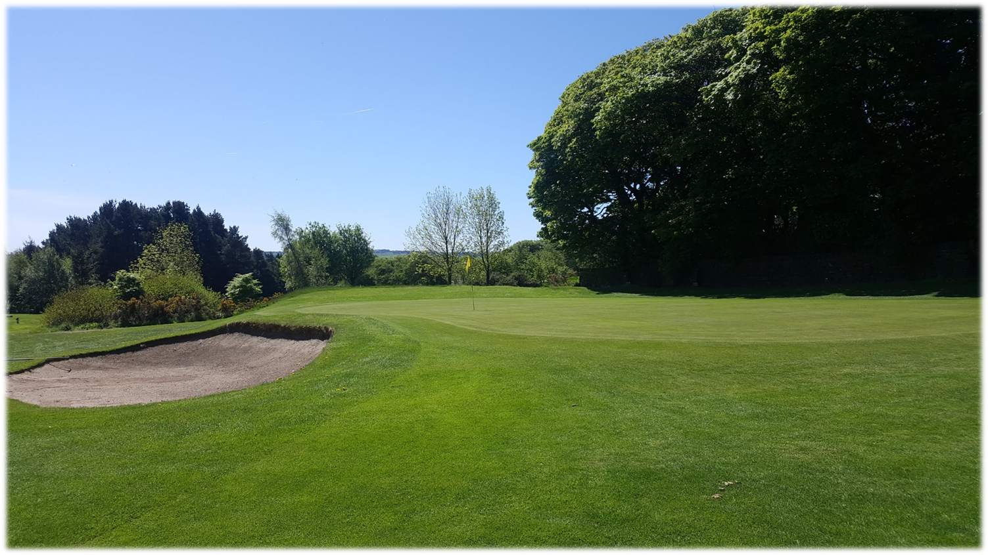
The Senior Pairs Open 2023
Results
Position | Team Members |  | Stableford Points | Prize Vouchers
1st Place | D Smith | D Snazel | 49 points | £250 per team
2nd Place | R Leach | M Flanagan | 44 points (Countback) | £200 per team
3rd Place | P Walker | D Kemp | 44 points | £150 per team
4th Place | G Chapman | T Dad | 43 points (Countback) | £100 per team
5th Place | J Goodyear | R Helley | 43 points | £50 per team
Nearest the Pin in 2 (Hole 18): E Chan £25
Longest Drive (Hole 6): M Gration £25

